Slide 1
Image classification
Akshat Phumbhra

Slide 2
Introduction
Image classification is the basis of the field of computer vision
Here, we categorize the pixels of an image into one of 10 categories
This is one of the most basics of image classification
Previous solutions include models such as ResNet, DenseNet, and InceptionV3

Slide 3

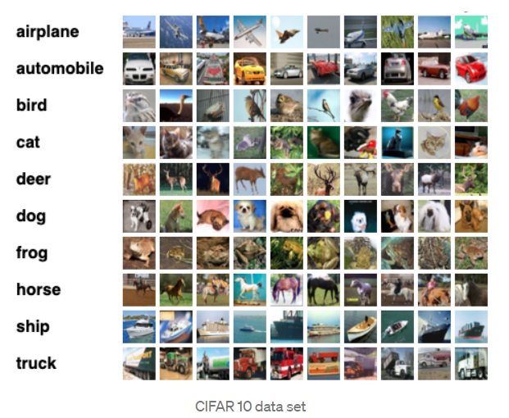
Dataset – cifar10
CIFAR stands for Canadian Institute For Advanced Research
The dataset is comprised of 60,000 32x32 pixel color photographs of objects from 10 classes
The class labels are - 0: airplane, 1: automobile, 2: bird, 3: cat, 4: deer, 5: dog, 6: frog, 7: horse, 8: ship, 9: truck.

Slide 4
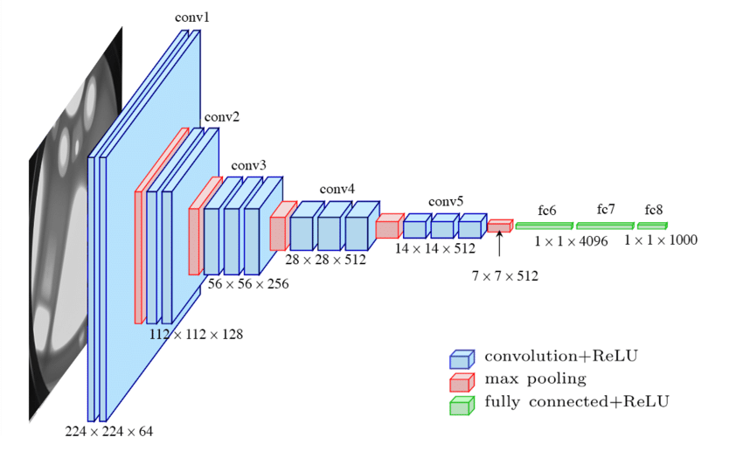
Proposed Method
The model is based on the general architectural principles of the VGG models
This architecture involves stacking convolutional layers with small 3x3 filters followed by a max pooling layer
Together these layers form a block. We repeat these blocks where each the number of filters in each block is increased with the depth of the network
Dropout is a technique that randomly drops nodes out of the network. This has a regularization effect as the remaining nodes must adapt to pick up the slack of the removed nodes
Finally, we add batch normalization in order to stabilize the learning and perhaps accelerate the learning process. Batch normalization is designed to automatically standardize the inputs to a layer

Slide 5
Evaluation method
We use classification accuracy to evaluate this model
We also create a plot of the cross-entropy loss and classification accuracy during the model fit process
The plot can help detect whether we are over or under fitting our model

Slide 6
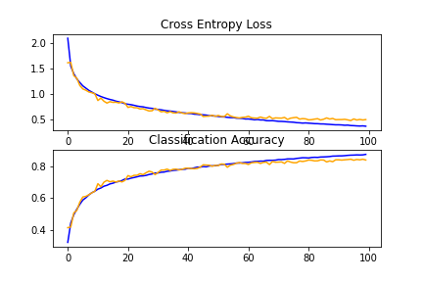
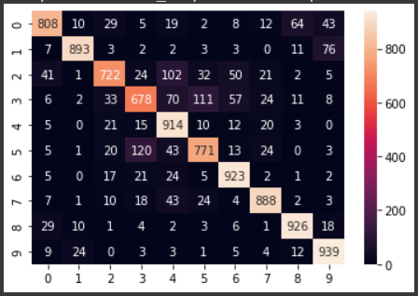
Results
The model achieved an 84.62% classification accuracy on the test set
We noticed that the model was considerably accurate when classifying non-living objects like airplanes or trucks
It often struggled to differentiate between the animals
It was most confused between cats and dogs, but sometimes between dogs and frogs

